Slide 1

Course Registration System
Jedi Group D

Slide 2
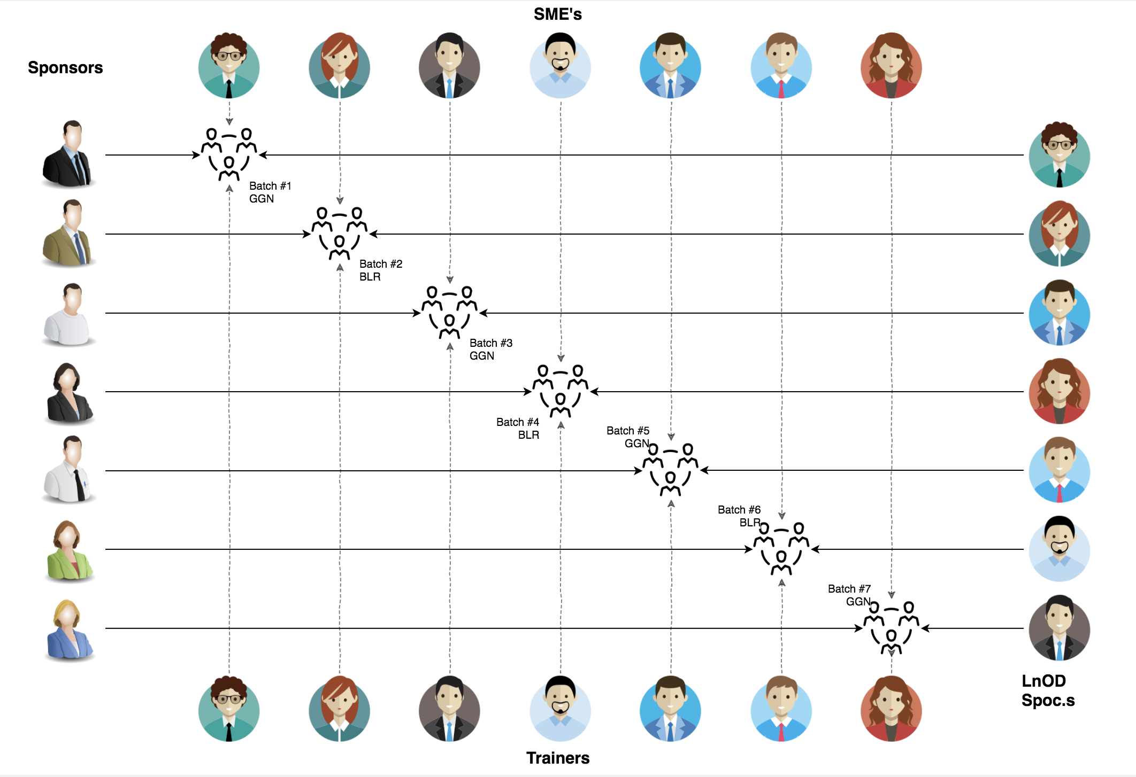
Stakeholders
1) Sponsors
Flipkart
2) SME
Amit Balyan
3) HR’s and Coordinators
Heena Bansal (HR)
Sharath Ramesha (L&D Team, Flipkart)
Ankur Sinha (University Relations)

Slide 3

Agenda
01
Our Team
02
Training Overview
03
Our Journey
04
Problem Statement
05
Engineering Practices
06
Architecture Design
07
Tech Stack
08
Demo
09
Challenges & Learnings
10
Questions
Notes:
Time – 1 min

Slide 4

Our Team
Notes:
Time – 2 mins

Slide 5
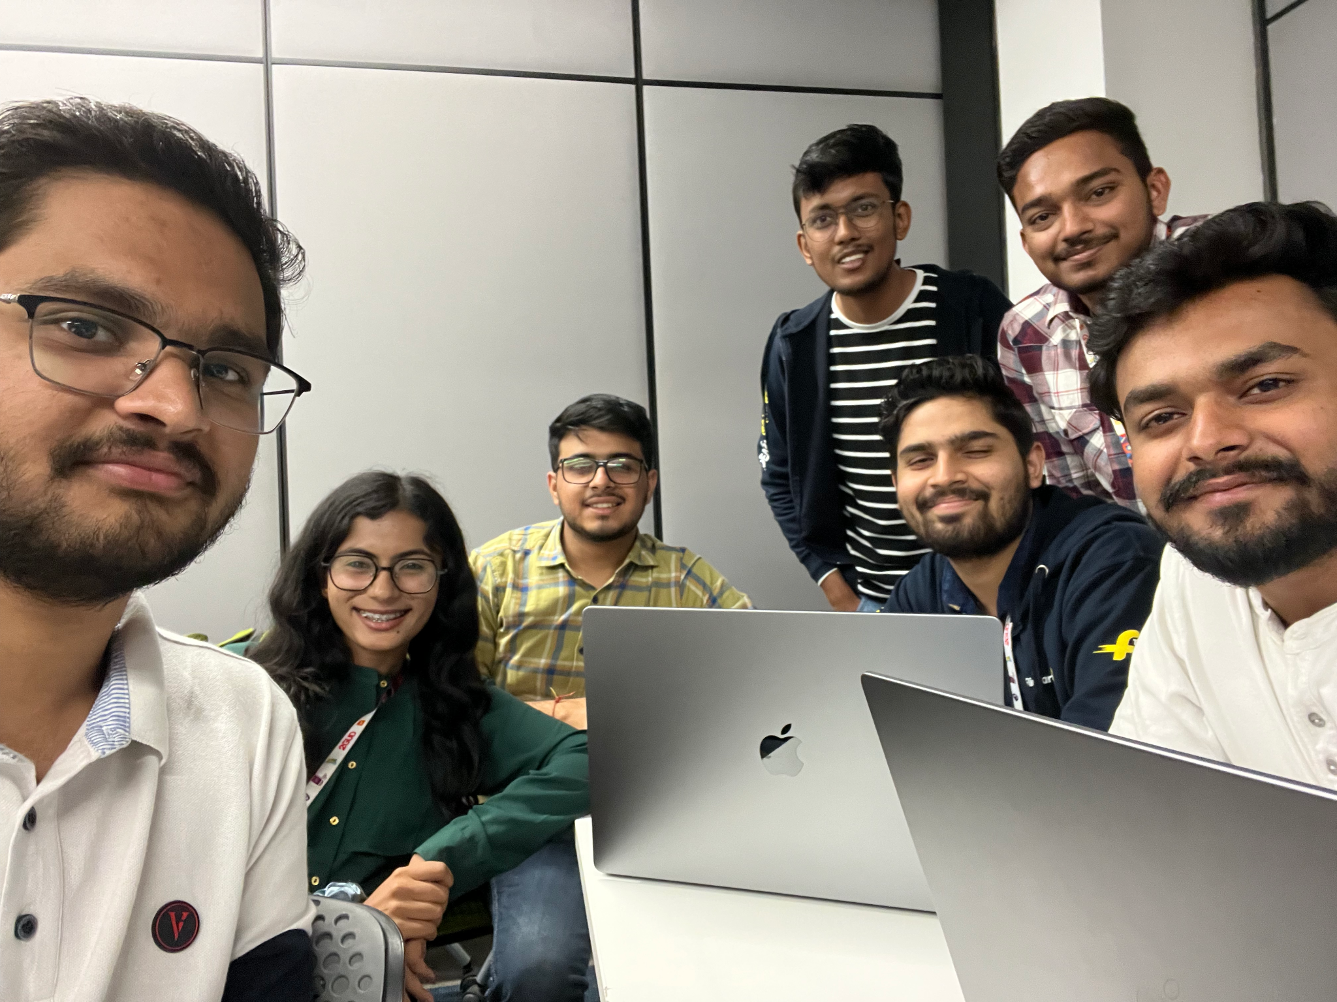
Ritik Taneja
Sarvesh Pal
Viraj
Disha Oza
Kushank Maheshwari
Kanwaraj Singh
Bhavya Ankhja

Slide 6
3 WEEKS OF TRAINING + PROJECT DEMO
13 DAYS
117 HOURS
7,020 MINUTES
4,21,200 SECONDS
LIMITLESS KNOWLEDGE
Notes:
Ritik Taneja
Next - Sarvesh

Slide 7

Our Journey
Notes:
Time - 2 mins

Slide 8
01.
02.
Unix & Git
UML Diagrams
Understanding Unix and Git Commands
Requirement Understanding and diagram design
04.
03.
Java 8
POS Application & SQL
Developing a POS application using Java and MySQL
Understanding basics of java and exception handling
Action Plan
05.
06.
Java REST
DropWizard
Understanding about Java RESTful services
REST API development using DropWizard

Slide 9

Project Goals
Notes:
Time – 3 mins

Slide 10

Problem Statement
To develop a POS application and REST API for Course Registration System using JAVA where the student can register, add/drop course, professors can view courses, enrolled students while admin can manage users, add/drop courses to catalog
Notes:
User satisfaction and brand value
Problem Statement

Slide 11
Course Registration System
Primary Actors
Admin
Professor
Student
Add Course to Catalog
Add Professor
Add Admin
Approve Student
Delete Course
View Added Professor
Show Course Catalog
Show Registered Students
Show Pending Students
Show Added Admin
Add new Semester
Open Semester Registration
Close Semester Registration
View Enrolled Students
Add Grade
View Assigned Courses
Register Course
Add Course
Drop Course
View Available courses
View Registered Courses
View Grade Card
Pay fees
Notes:
Sarvesh Pal

Slide 12
UML DIAGRAMS

Slide 13
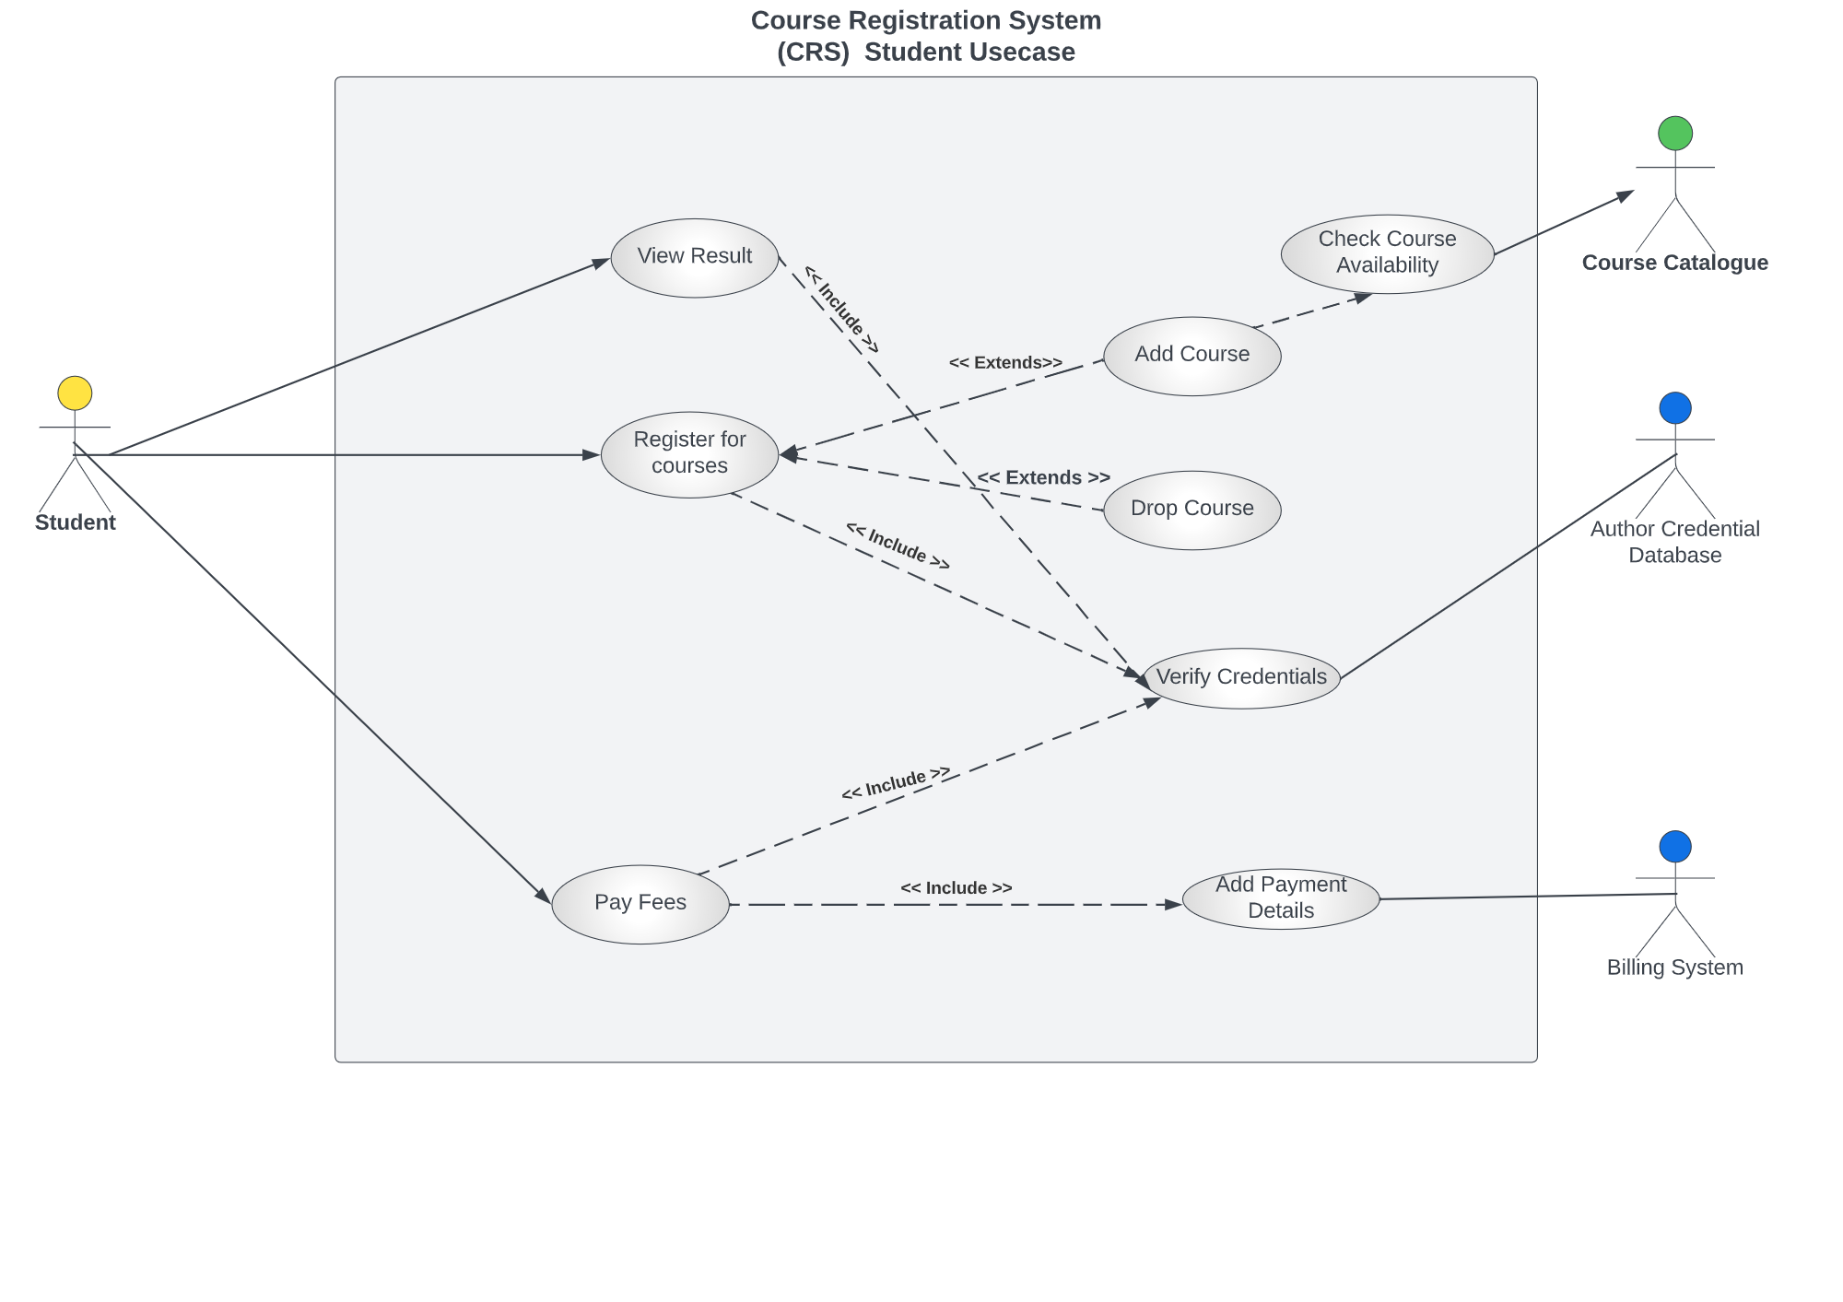
Use Case Diagram - Student

Slide 14
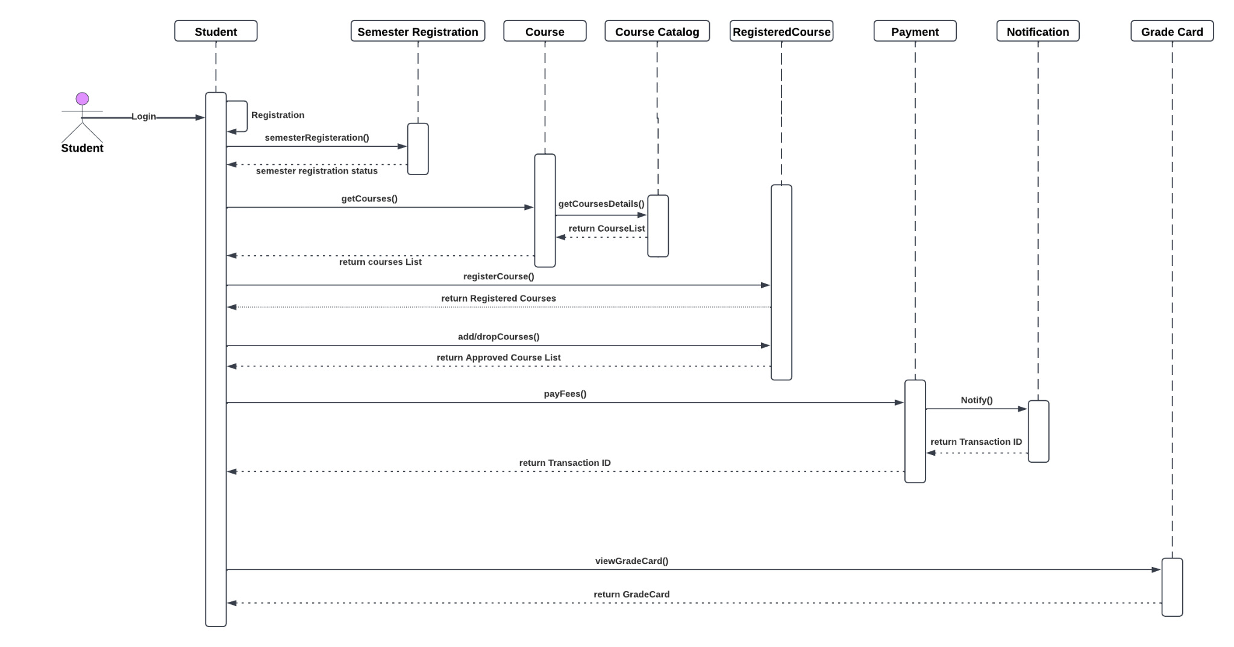
Sequence Diagram - Student

Slide 15
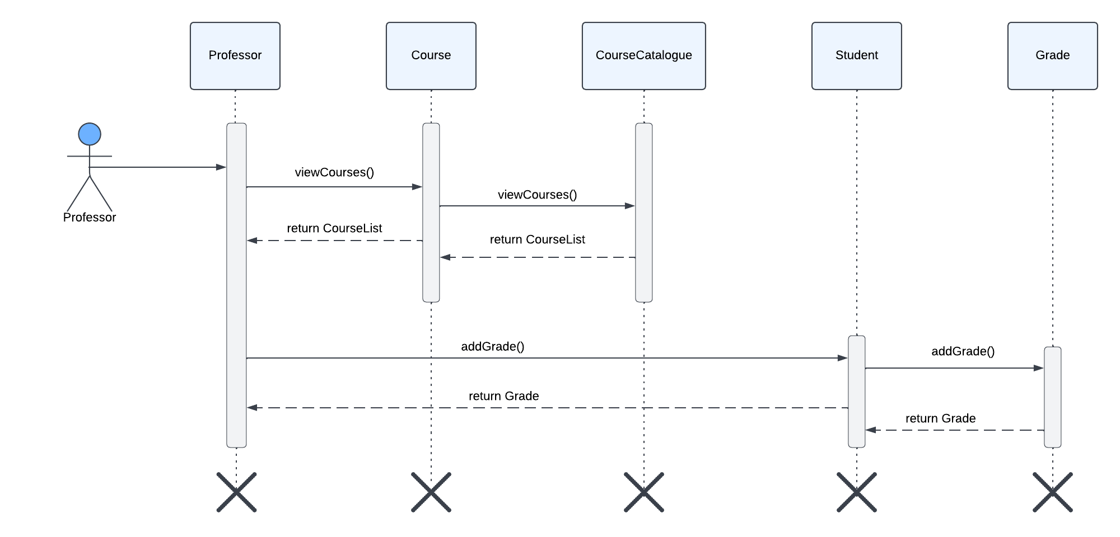
Sequence Diagram - Professor

Slide 16
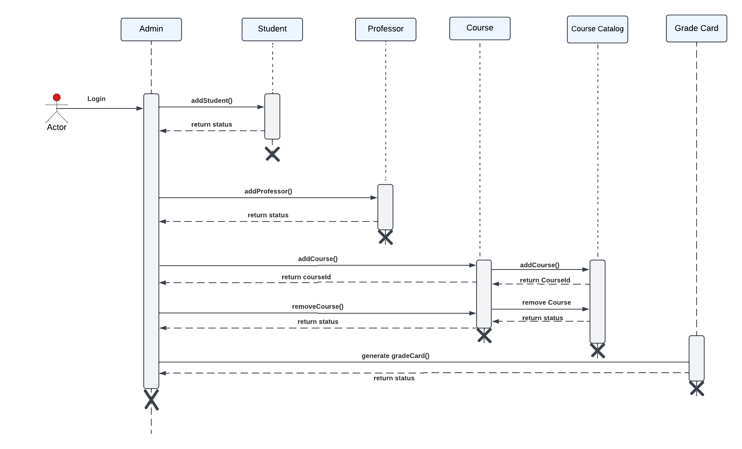
Sequence Diagram - Admin

Slide 17

Engineering Practices
Notes:
Time – 5 mins

Slide 18
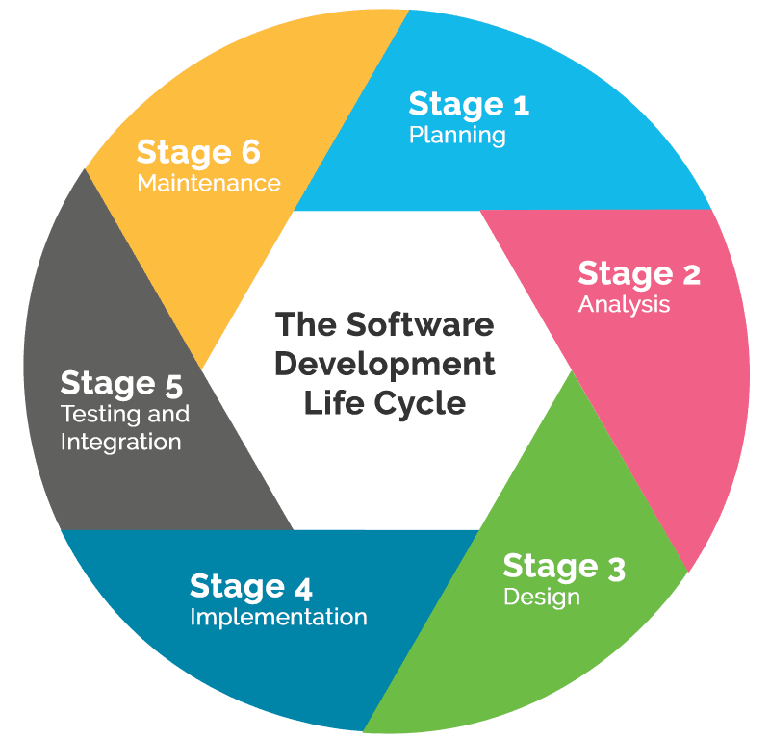
Requirement Gathering
Tech Stack Selection
Testing & Bug Fixes
UML Artifacts, Architecture Design
Code development

Slide 19
Demo
Mindset
5
Deployed the project using JAVA and Dropwizard
Process
4
Wrote JAVA core production code for the problem based on UML models.
Tools
3
Decided the Technologies JAVA/SQL/REST/Dropwizard/Git
Comprehend
2
Designed the Use-case, activity, class and sequence diagrams for the problem.
1
Started with linux and git. Learned UML and SDLC and done analysis of problem statement using UML modelling.

Slide 20

Architecture Design
Notes:
Time – 1 min

Slide 21




Application Flow
REST Client
Business Layer
Data Access Object(DAO) Layer
Database
After:
HTTP Request
HTTP Response
Before:
stdin/stdout
CLI Client
Notes:
n-tier

Slide 22
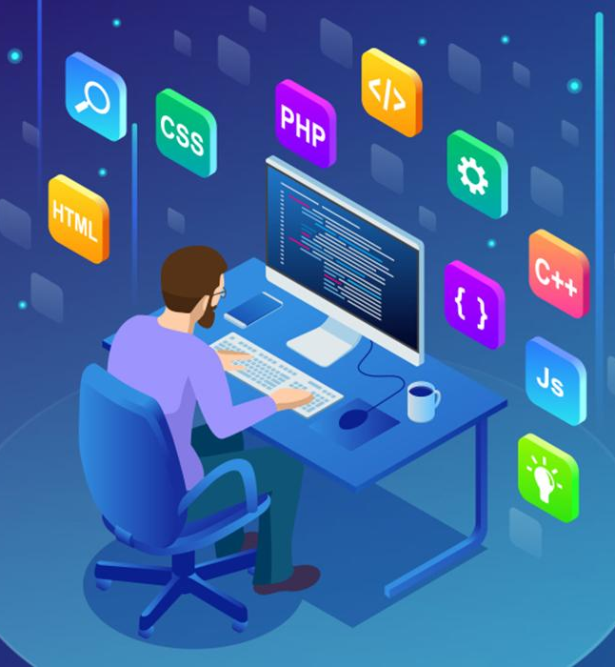
Tech Stack
Notes:
Time – 2 mins

Slide 23












Designing
Backend
Testing
Data
SCM
UML
Core Language
Tools
SQL Database
Code Collaboration
Framework
Application Server
Notes:
Time – 1 min
Java
Maven
DropWizard
MySQL
Jersey
GitHub
Postman / ARC (Check it)
StarUML / Dia / Lucid Charts
List
Design
Backend
Testing
Tools

Slide 24

Demo
UML Artifacts
POS Application
Rest Application
Dropwizard Application
Git repo - https://github.com/ritiktaneja/Flipkart-JEDI-Group-D-CRS

Slide 25

Challenges & Learnings
Notes:
Time – 2 mins

Slide 26
CHALLENGES
Understanding the problem statement and initial implementation using Use Case, activity, sequence and class diagram.
Installing software on multiple environments.
Git merge conflicts.
Resolving jar and version dependencies.
Database integration challenges.
Working with DropWizard .

Slide 27
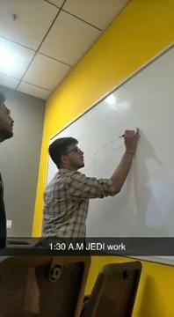
LEARNINGS
Working as a team.
Learning the basic Git commands.
Familiarization with Unix Commands.
Software Development Life Cycle.
Knowledge and Implementation of UML Diagrams
Java 8 features, SQL .
Dropwizard Integration and Advantages.

Slide 28

Questions
Notes:
Time - ?

Slide 29
Thank you
Notes:
Time – After this show the testimonial video. 1 min

